Slide 1

Fundamentals of Artificial Intelligence
Search
Instructor: Dr. Hatim Alsuwat
Umm Al-Qura University

Slide 2

State Space Graphs and Search Trees

Slide 3
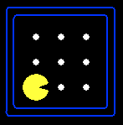


State Space Graphs
State space graph: A mathematical representation of a search problem
Nodes are (abstracted) world configurations
Arcs represent successors (action results)
The goal test is a set of goal nodes (maybe only one)
In a state space graph, each state occurs only once!
We can rarely build this full graph in memory (it’s too big), but it’s a useful idea

Slide 4
State Space Graphs
State space graph: A mathematical representation of a search problem
Nodes are (abstracted) world configurations
Arcs represent successors (action results)
The goal test is a set of goal nodes (maybe only one)
In a search graph, each state occurs only once!
We can rarely build this full graph in memory (it’s too big), but it’s a useful idea
a
G
b
c
e
d
f
S
h
p
q
r
Tiny search graph for a tiny search problem

Slide 5
Search Trees
This is now / start
“N”, 1.0
“E”, 1.0
Possible futures
A search tree:
A “what if” tree of plans and their outcomes
The start state is the root node
Children correspond to successors
Nodes show states, but correspond to PLANS that achieve those states
For most problems, we can never actually build the whole tree

Slide 6
State Space Graphs vs. Search Trees
State Space Graph
Each NODE in in the search tree is an entire PATH in the state space graph.
Search Tree
S
a
G
d
e
p
b
c
q
b
c
e
h
r
d
e
f
a
a
h
r
p
q
f
S
h
We construct both on demand – and we construct as little as possible.
p
q
f
q
c
G
p
q
r
q
c
G
a
a

Slide 7

Quiz: State Space Graphs vs. Search Trees
Consider this 4-state graph:
How big is its search tree (from S)?
a
S
G
b
Important: Lots of repeated structure in the search tree!

Slide 8
Tree Search

Slide 9
Search Example: Romania

Slide 10
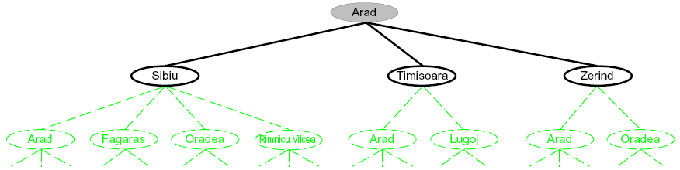
Searching with a Search Tree
Search:
Expand out potential plans (tree nodes)
Maintain a fringe of partial plans under consideration
Try to expand as few tree nodes as possible

Slide 11
General Tree Search
Important ideas:
Fringe
Expansion
Exploration strategy
Main question: which fringe nodes to explore?

Slide 12
Example: Tree Search
a
G
b
c
d
e
f
S
h
p
q
r
Notes:
Left: show tree
Right: fringe

Slide 13

Depth-First Search

Slide 14
Depth-First Search
Strategy: expand a deepest node first
Implementation: Fringe is a LIFO stack
a
G
a
c
b
c
b
e
d
e
d
f
f
S
h
h
p
p
r
q
r
q
S
d
e
p
b
c
e
h
r
q
a
a
h
r
p
q
f
p
q
f
q
c
G
q
c
G
a
a

Slide 15
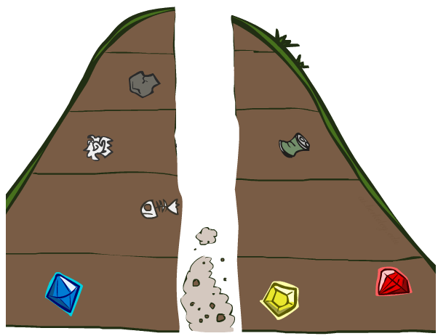
Search Algorithm Properties

Slide 16
Search Algorithm Properties
Complete: Guaranteed to find a solution if one exists?
Optimal: Guaranteed to find the least cost path?
Time complexity?
Space complexity?
Cartoon of search tree:
b is the branching factor
m is the maximum depth
solutions at various depths
Number of nodes in entire tree?
1 + b + b² + …. b^{m} = O(b^{m})
1 node
b
…
b nodes
b² nodes
m tiers
b^{m} nodes

Slide 17
Depth-First Search (DFS) Properties
What nodes DFS expand?
Some left prefix of the tree.
Could process the whole tree!
If m is finite, takes time O(b^{m})
How much space does the fringe take?
Only has siblings on path to root, so O(bm)
Is it complete?
m could be infinite, so only if we prevent cycles (more later)
Is it optimal?
No, it finds the “leftmost” solution, regardless of depth or cost
1 node
b
…
b nodes
b² nodes
m tiers
b^{m} nodes

Slide 18
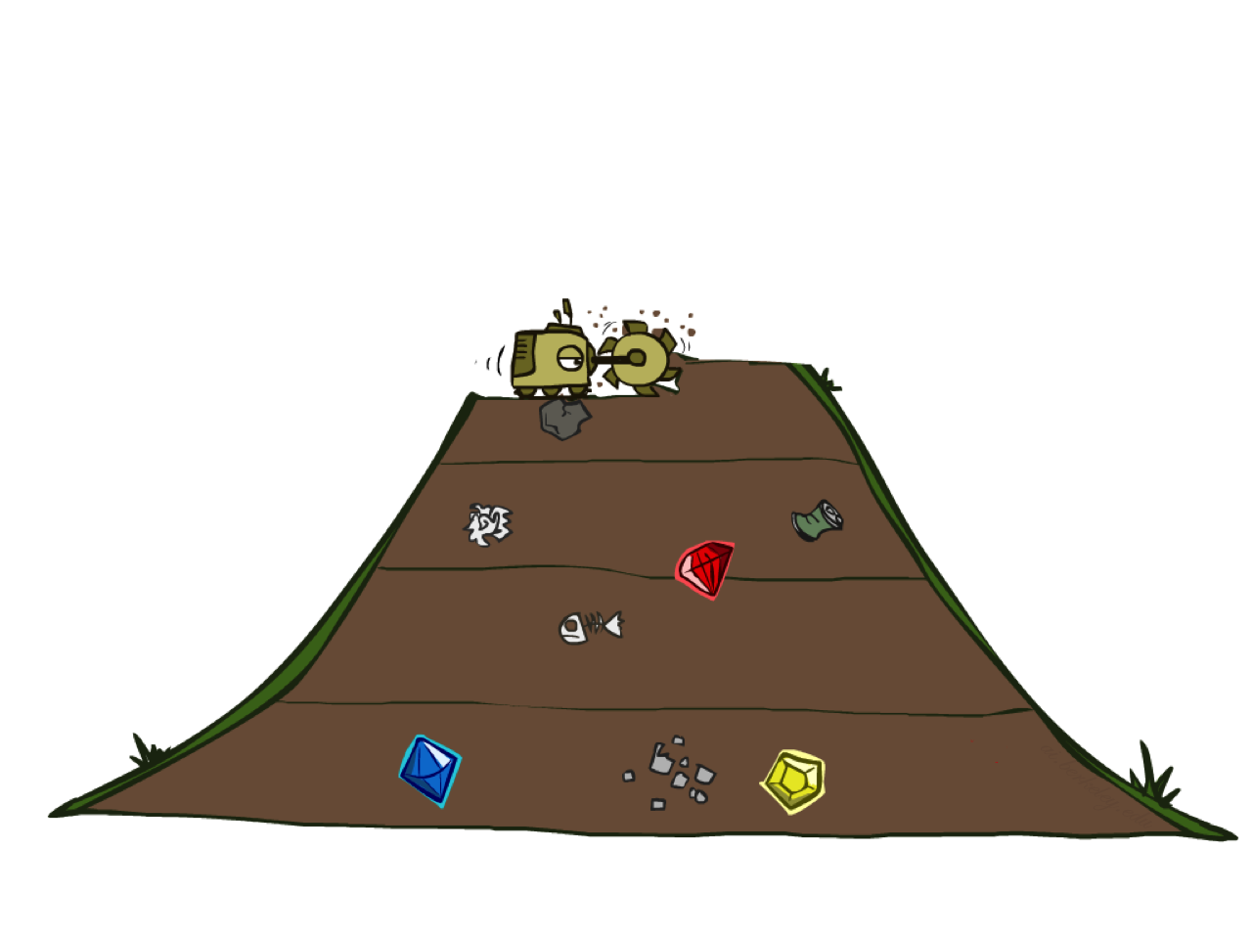
Breadth-First Search

Slide 19
Breadth-First Search
Strategy: expand a shallowest node first
Implementation: Fringe is a FIFO queue
a
G
b
c
d
e
f
S
h
p
q
r
S
d
e
p
Search
Tiers
b
c
e
h
r
q
a
a
h
r
p
q
f
p
q
f
q
c
G
q
c
G
a
a

Slide 20
Breadth-First Search (BFS) Properties
What nodes does BFS expand?
Processes all nodes above shallowest solution
Let depth of shallowest solution be s
Search takes time O(b^{s})
How much space does the fringe take?
Has roughly the last tier, so O(b^{s})
Is it complete?
s must be finite if a solution exists, so yes!
Is it optimal?
Only if costs are all 1 (more on costs later)
1 node
b
…
b nodes
s tiers
b² nodes
b^{s} nodes
b^{m} nodes

Slide 21
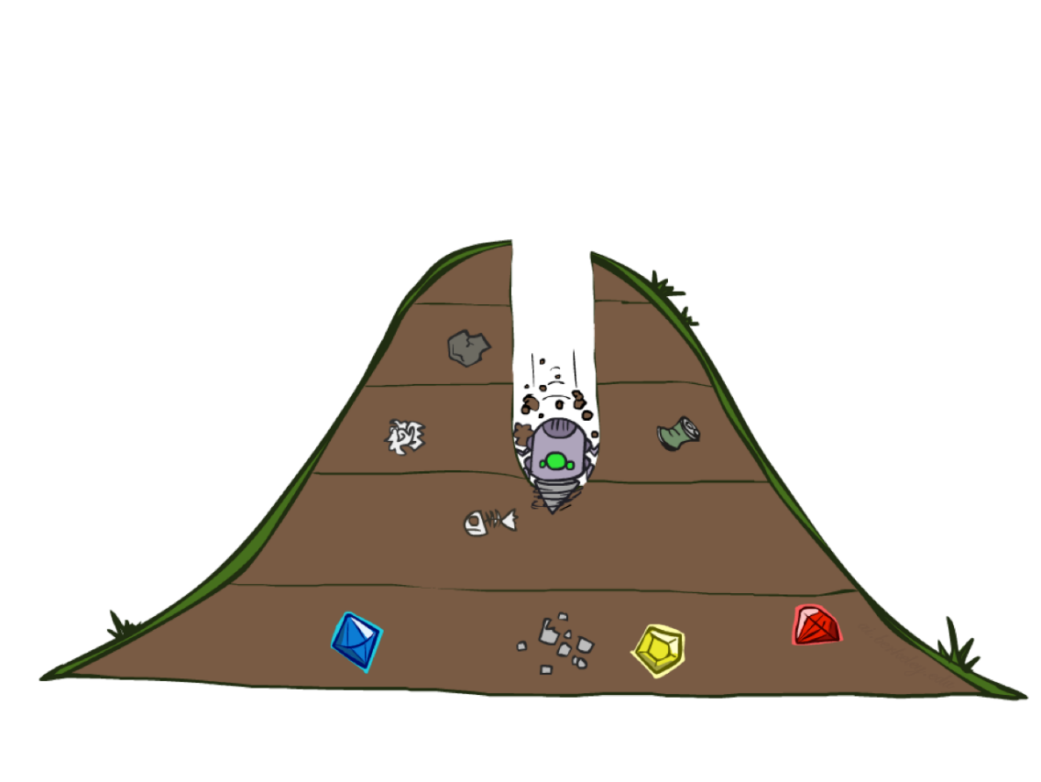
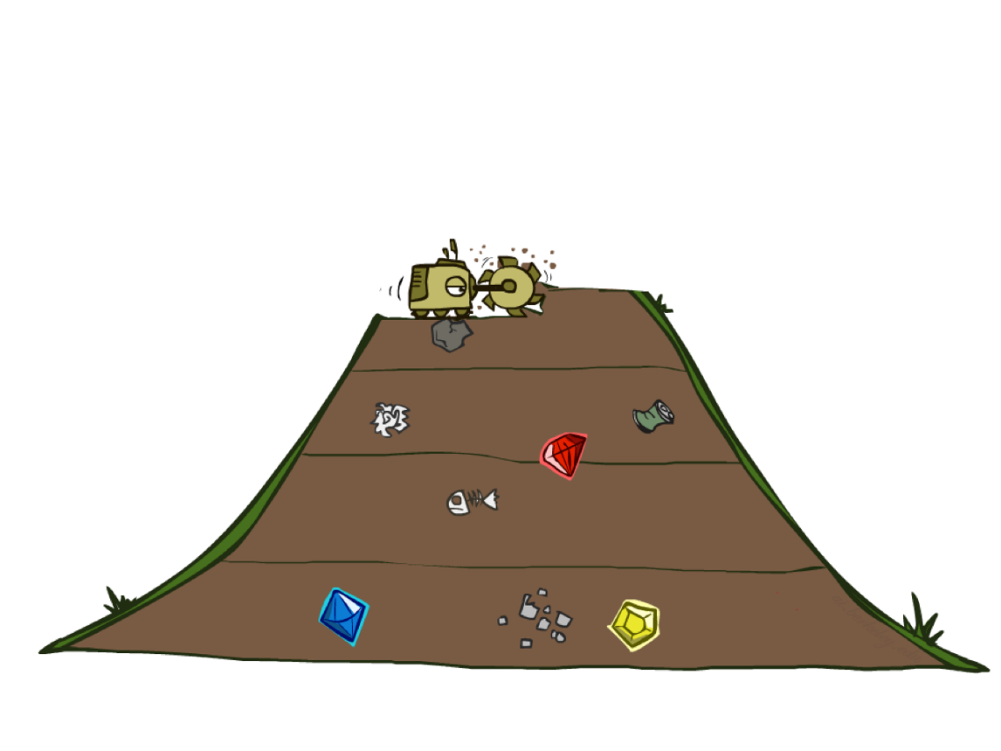
Quiz: DFS vs BFS

Slide 22
Quiz: DFS vs BFS
When will BFS outperform DFS?
When will DFS outperform BFS?
[Demo: dfs/bfs maze water (L2D6)]

Slide 23

Video of Demo Maze Water DFS/BFS (part 1)

Slide 24
Video of Demo Maze Water DFS/BFS (part 2)

Slide 25
Iterative Deepening
Idea: get DFS’s space advantage with BFS’s time / shallow-solution advantages
Run a DFS with depth limit 1. If no solution…
Run a DFS with depth limit 2. If no solution…
Run a DFS with depth limit 3. …..
Isn’t that wastefully redundant?
Generally most work happens in the lowest level searched, so not so bad!
b
…

Slide 26
Iterative deepening search
To avoid the infinite depth problem of DFS, we can
decide to only search until depth L, i.e. we don’t expand beyond depth L.
→ Depth-Limited Search
What of solution is deeper than L? → Increase L iteratively.
→ Iterative Deepening Search
As we shall see: this inherits the memory advantage of Depth-First
search.

Slide 27
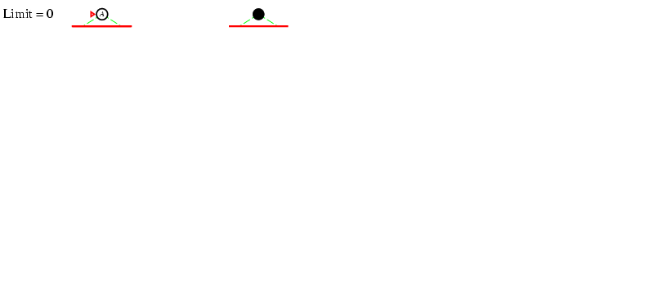
Iterative deepening search L=0

Slide 28
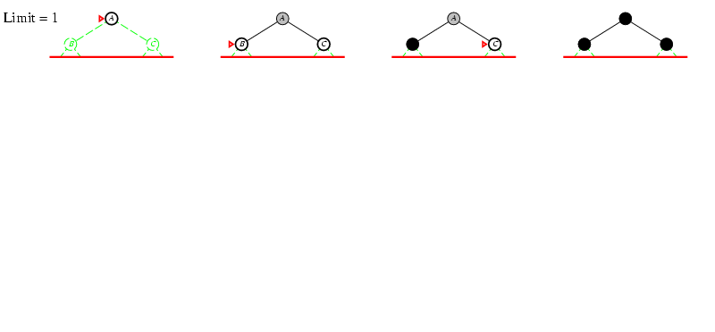
Iterative deepening search L=1

Slide 29
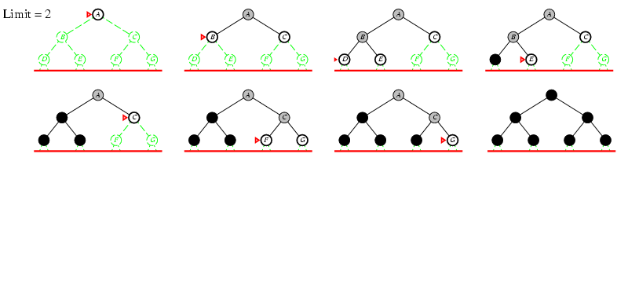
Iterative deepening search lL=2

Slide 30
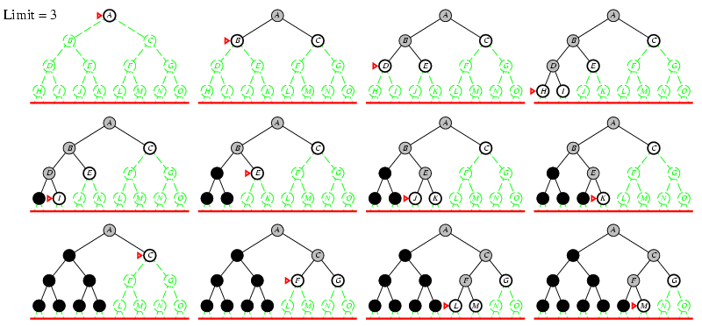
Iterative deepening search lL=3

Slide 31
Cost-Sensitive Search
a
GOAL
2
2
b
c
3
2
1
8
2
e
d
f
3
9
8
2
START
h
1
4
2
p
4
r
15
q
BFS finds the shortest path in terms of number of actions.
It does not find the least-cost path. We will now cover
a similar algorithm which does find the least-cost path.

Slide 32

Uniform Cost Search

Slide 33
Uniform Cost Search
2
G
a
Strategy: expand a cheapest node first:
Fringe is a priority queue (priority: cumulative cost)
b
c
1
8
2
2
e
3
d
f
9
8
2
S
h
1
1
p
q
r
15
0
S
d
3
e
9
p
1
b
4
e
5
h
17
r
11
q
16
c
11
Cost contours
a
6
a
h
13
r
7
p
q
f
p
q
f
8
q
c
G
q
c
a
11
G
10
a

Slide 34
Uniform Cost Search (UCS) Properties
What nodes does UCS expand?
Processes all nodes with cost less than cheapest solution!
If that solution costs C* and arcs cost at least ε , then the “effective depth” is roughly C*/ε
Takes time O(b^{C*/ε}) (exponential in effective depth)
How much space does the fringe take?
Has roughly the last tier, so O(b^{C*/ε})
Is it complete?
Assuming best solution has a finite cost and minimum arc cost is positive, yes!
Is it optimal?
Yes! (Proof next lecture via A*)
b
c ≤ 1
…
C*/ε “tiers”
c ≤ 2
c ≤ 3

Slide 35
Uniform Cost Issues
Remember: UCS explores increasing cost contours
The good: UCS is complete and optimal!
The bad:
Explores options in every “direction”
No information about goal location
We’ll fix that soon!
…
c ≤ 1
c ≤ 2
c ≤ 3
Start
Goal
[Demo: empty grid UCS (L2D5)]
[Demo: maze with deep/shallow water DFS/BFS/UCS (L2D7)]

Slide 36
Video of Demo Empty UCS

Slide 37

The One Queue
All these search algorithms are the same except for fringe strategies
Conceptually, all fringes are priority queues (i.e. collections of nodes with attached priorities)
Practically, for DFS and BFS, you can avoid the log(n) overhead from an actual priority queue, by using stacks and queues
Can even code one implementation that takes a variable queuing object

Slide 38
Video of Demo Maze with Deep/Shallow Water --- DFS, BFS, or UCS? (part 1)

Slide 39
Video of Demo Maze with Deep/Shallow Water --- DFS, BFS, or UCS? (part 2)

Slide 40
Video of Demo Maze with Deep/Shallow Water --- DFS, BFS, or UCS? (part 3)

